Slide 1
Zoom Games
Embrace the Chaos
Sarah Johnson, Ethan Kohrt, Jake LaMotte, Boone Tison

Slide 2
introduction
Research Question: Is there an untapped area for gaming in videoconferencing software?
Motivation: Connect people in new and different ways
Main Claim
There is a market for games on videoconferencing software
Boone

Slide 3

Background
Literature Review
2007 study, “Mafia” over videoconferencing software had similar levels of enjoyment as in-person play (Batcheller, 2007).
Three-player pong, leveraged separation of players for experience (Mueller, 2006).
Long-distance family connections using videoconferencing software, software suggestions for playing with children (Follmer, 2010).
Competitive Analysis
“Caribu” app – games or storybooks with children over a video call
Games played via videoconferencing with minor adjustments
Ethan Image Source: [1]

Slide 4

Methods / Analysis
Qualtrics survey of 14 questions
College students and faculty
26 responses
Semi-structured interviews
Three participants
Diverse ideas from survey
Image Source: [4]
Jake

Slide 5
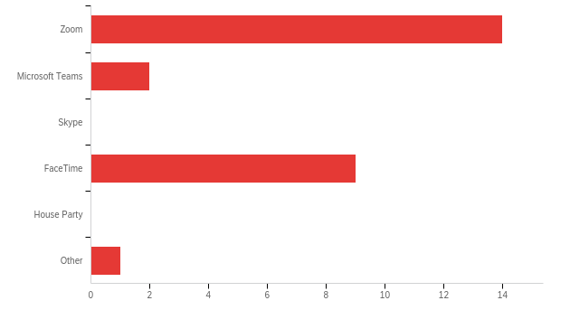
Survey Results
Interested in videoconferencing games: (84.6%)
Most popular contexts were “socializing with friends,” “virtual events,” and “school”
Duration of games: 2-3 minutes (66.7%), 30 second turn-based (23.8%)
Most used software: Zoom (53.8%), FaceTime (34.6%)
Image Source: [4]
Boone

Slide 6
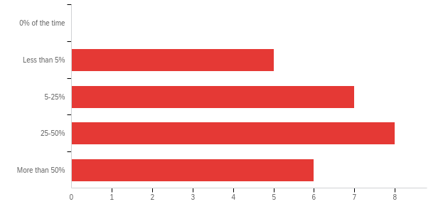
Survey Results
Size of games: 3+ people (66.7%)
Only 4 people had played games over video call
Rated experience on a scale of 1-5, average was 2.5
Multitasking during calls: Less than 25% (46.1%), More than 25% (53.9%)
Image Source: [4]
Boone

Slide 7
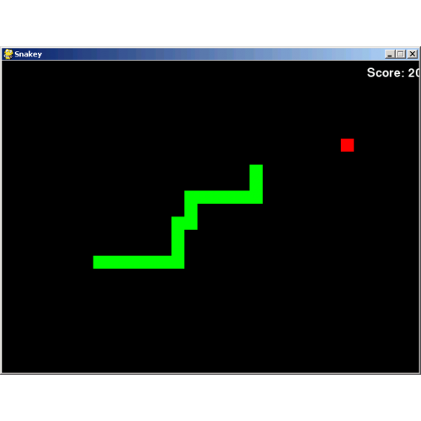

Interview Results
Ideal group size of 3-5 people
Ideal duration is short, around 5 minutes
Generally bored during meetings
Looked elsewhere for entertainment, such as games
Image Source: [2]
Image Source: [3]
Sarah

Slide 8
Conclusion
Zoom is the most popular platform, while also seen as boring.
People want short games with medium (5-10) group sizes
Untapped market
Ethan

Slide 9
Bibliography
Batcheller, Archer L., Brian Hilligoss, Kevin Nam, Emilee Rader, Marta Rey-Babarro, and Xiaomu Zhou. “Testing the Technology: Playing Games with Video Conferencing.” In Proceedings of the SIGCHI Conference on Human Factors in Computing Systems - CHI ’07. ACM Press, 2007. https://doi.org/10.1145/1240624.1240751.
Follmer, Sean, Hayes Raffle, Janet Go, Rafael Ballagas, and Hiroshi Ishii. “Video Play.” In Proceedings of the 9th International Conference on Interaction Design and Children - IDC ’10. ACM Press, 2010. https://doi.org/10.1145/1810543.1810550.
Mueller, Florian “Floyd,” and Martin Gibbs. “A Table Tennis Game for Three Players.” In Proceedings of the 20th Conference of the Computer-Human Interaction Special Interest Group (CHISIG) of Australia on Computer-Human Interaction: Design: Activities, Artefacts and Environments - OZCHI ’06. ACM Press, 2006. https://doi.org/10.1145/1228175.1228234.

Slide 10
Images
1. https://twitter.com/jackboxgames/status/1067481418576596993/photo/1
2. https://www.learningtogive.org/file/4930
3. https://veryutils.com/snake-classic-python-game-template
4. https://www.qualtrics.com/

